Slide 1

SAT and ACT Analysis
By Tenzin Wangdu

Slide 2
Background
 | SAT | ACT
Total Time | 2:55 hours without writing 3:55 hours with Writing | 3 hours without Essay 3:50 hours with Essay
Sections | Math/English | Math/Reading/English/Science
Score | 200-800 per Sections 400-1600 Total Combine Score | 1-36 Per Sections 1-36 for a Composite Score
Who Accepts the Scores? | Accepted by all colleges and universities in the US | Accepted by all colleges and universities in the US

Slide 3
Problem Statement
In order to raise the participation rate for both exam, the college board wants to figure out where to allocate their resources to increase the test takers.

Slide 4
Data Sets
SAT:
From 2019
50 states
Participation Rates
Section Scores
Total Scores
ACT:
From 2019
50 states
Participation Rates
Composite Scores
SAT & ACT Requirement by State:
50 States
Act Require by State
Sat Require by State

Slide 5
DATA EXPLORATION AND VISUALIZATION

Slide 6
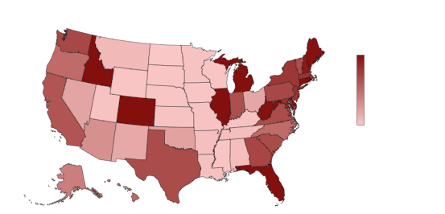
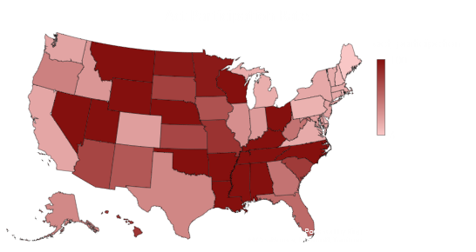
HIGHEST PARTICIPATION IN SAT AND ACT BY STATES
While the Mid-west and Central has higher Act participation
East and West coast have higher Sat participation
15 state have 100% percent act participation and 8 state in Sat

Slide 7
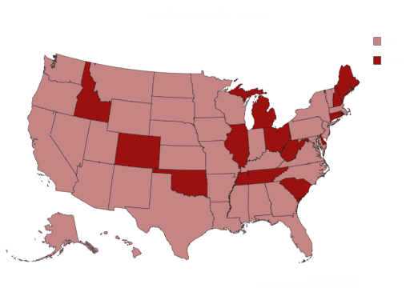
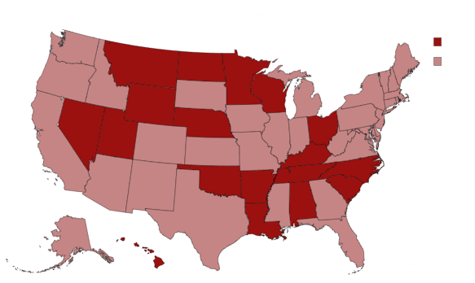
SAT And Act Requirement by State
27 States require either one of the test
Some states have the option of taking one of them
23 States don’t require either of the test

Slide 8
States with both test participation over 50%
Hawaii, North Carolina and South Carolina all required One of Test to taken
Florida’s 12 state universities required an Sat or Act score
Florida give Free test sessions provided by the school

Slide 9
State that needs help in Both Exam Participation
Oregon and Alaska have both below 52 % participation in each exam
Oregon Public Universities doesn’t require Sat and Act
Alaska unrestricted the graduation requirement on 2016 from require to take the sat to no longer needed.

Slide 10
Conclusions and Recommendations
Based on the exploration of the data, the key takeaways are less than half of the state are require to take both tests. You can increase the participation in Oregon and Alaska by mandating the tests by school districts.
Also another recommendation would be to have Sat or Act on a weekday for student who have worked and obligations on weekdays
Making the test free or less expensive would make much accessible
Giving first time generation and low income student more prep and guidance

Slide 11
Limitations
COVID-19 has make all test unethical
Most Colleges have make all test optional due to COVID-19
Some states like Oregon believe that Sat and Act have strong ties between family income and performance

Slide 12


